Slide 1
Energy: Spending, Saving and Supporting Carbon Reduction
12th April 2022
Steve Creighton – Head of Member Services

Slide 2
Today’s gas & power market

Slide 3
How we got here, it’s not all about the present!
Carbon
Storage
Global demand
Generation
Supply
Investment
Geopolitical
Weather

Slide 4
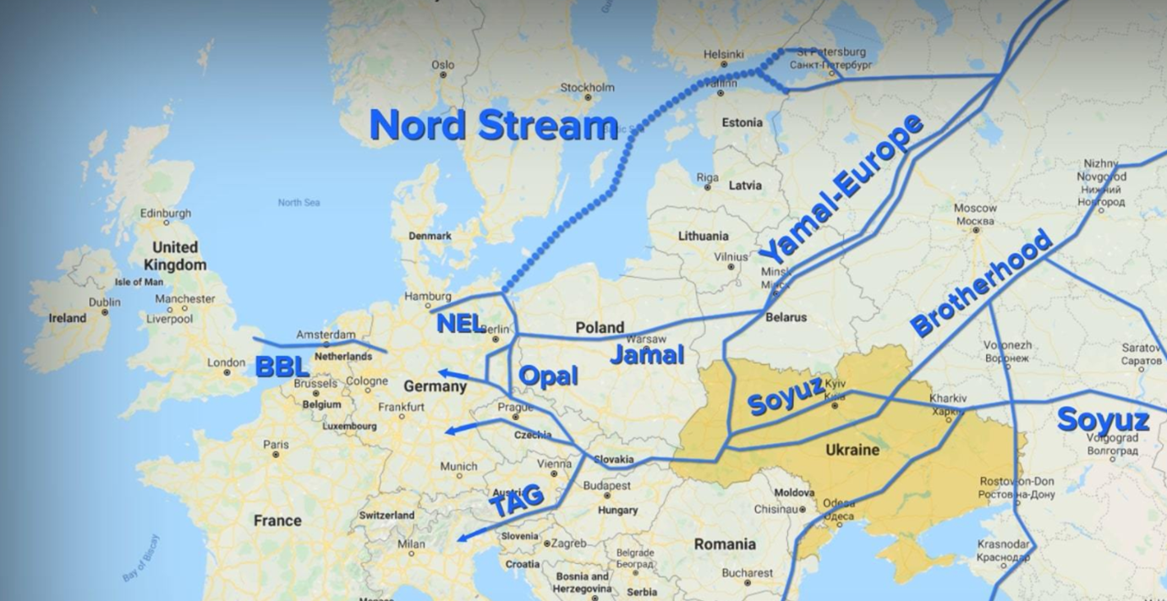
European supply

Slide 5
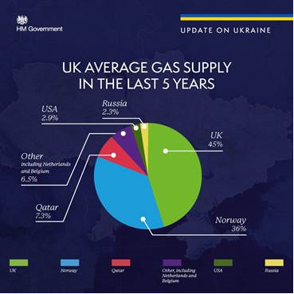
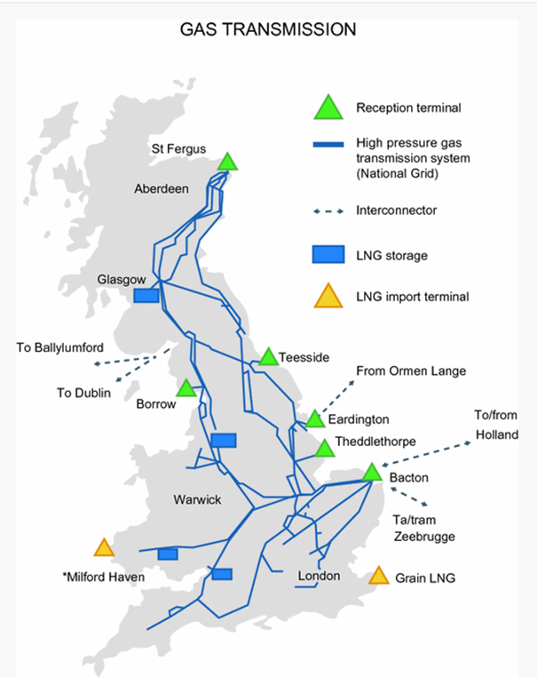
UK Security of supply

Slide 6
European storage

Slide 7
What’s next?

